Slide 1
Welcome to the English speaking practice course
Trainer: Muhammad Sami Co-Trainer: Jaweria Batool Moderators: Ahmad Hassan & Tayyaba Tabassum

Slide 2
Parts of speech & Sentence structure

Slide 3
Parts of Speech:
(Nouns, Pronouns, Verbs, Adjectives, Adverbs, Prepositions, Conjunctions Interjections)
A noun is a word used to name a person, place, thing, or idea. Examples: cat, house, book, happiness.
A pronoun is a word used in place of a noun. Examples: I, you, he, she, it, we, they, me, him, her, us, them.
A verb is a word that expresses an action or state of being. Examples: run, sit, be, have, do.
An adjective is a word that describes a noun or pronoun. Examples: red, big, small, happy.
5. An adverb is a word that modifies a verb, adjective, or another adverb. Examples: quickly, soundly, very, often.
6. A preposition is a word that shows the relationship between nouns or pronouns. Examples: in, on, under, over, behind, in front of.
7. A conjunction is a word that connects words, phrases, or clauses. Examples: and, but, or, because, so.
8. An interjection is a word that expresses emotion or surprise. Examples: Ouch!, Wow!, Hurray!
Wow! The cute puppy played happily in its ground.
Interjection Noun Adjective Noun Verb Adverb Preposition Pronoun Noun

Slide 4
Common Errors in Sentence Structure
Word Order: Maintain the correct word order (subject, verb, object).
Tenses: Use the correct verb tense to indicate when the action happened.
Article Usage: Use articles (a, an, the) correctly.
Prepositions: Use prepositions correctly to show relationships between words.

Slide 5
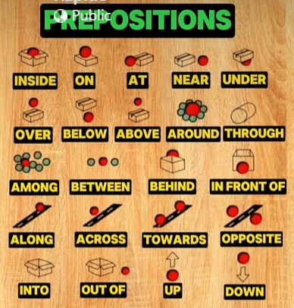
Prepositions

Slide 6
Types of Sentences
Simple Sentence: Contains one independent clause. Example: The cat chased the mouse.
Compound Sentence: Contains two or more independent clauses joined by a coordinating conjunction (and, but, or, nor, for, yet, so). Example: The cat chased the mouse, and the mouse ran away.
Complex Sentence: Contains one independent clause and one or more dependent clauses joined by a subordinating conjunction. (As, So, If, While) Example: Because the cat was hungry, it chased the mouse, which ran away.
Compound-Complex Sentence: Contains two or more independent clauses and one or more dependent clauses. Example: Because the cat was hungry and the mouse was scared, it chased the mouse, which ran away into a hole.

Slide 7
Coherence & cohesion
Coherence:
The logical flow and connection between ideas in your writing.
Cohesion:
The use of linking words and phrases to connect sentences and paragraphs.
Use transition words and phrases
e.g. however, in addition, furthermore) to improve coherence and cohesion.

Slide 8
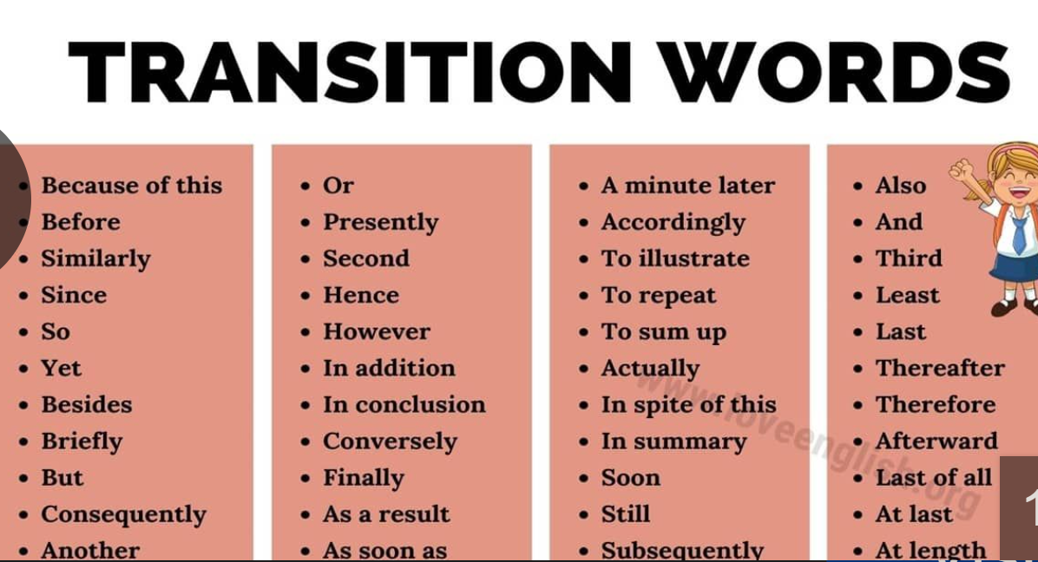
Transition Words
Difference between Transition words and Conjunctions: Transitions connect ideas at the level of paragraphs or larger units of text, while conjunctions connect elements within a sentence.

Slide 9
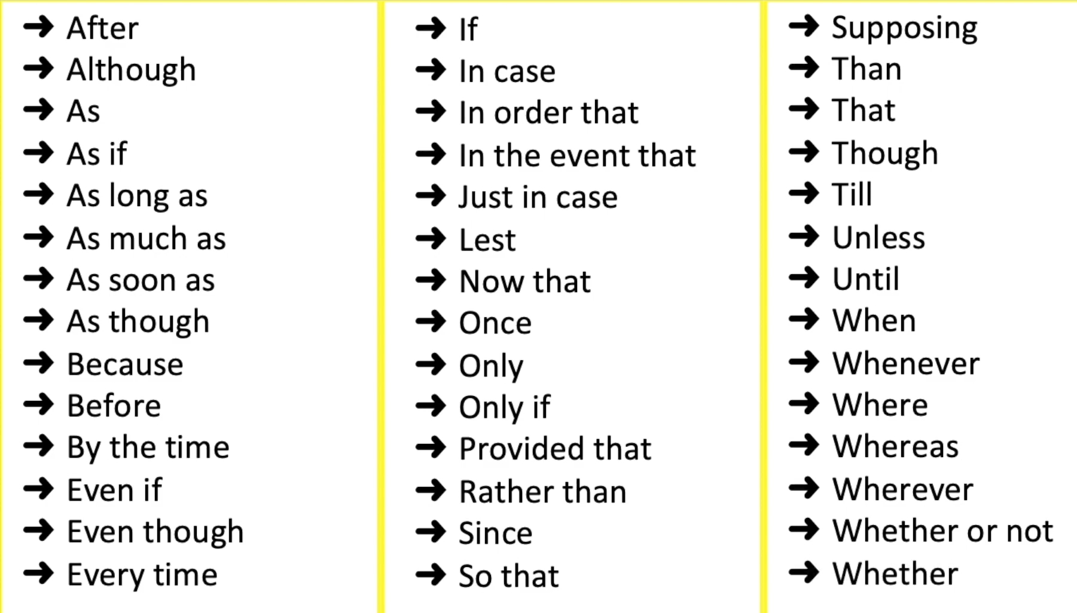
Conjunctions:

Slide 10
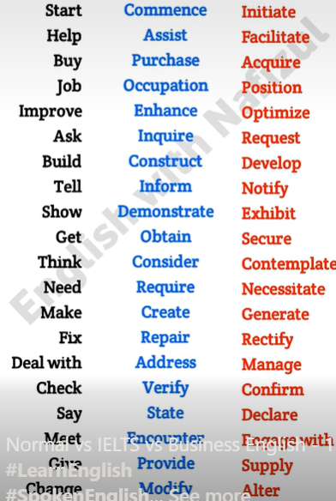
vocabulary

Slide 11
Commonly mis-pronounced words:
Wednesday – Wenzday
Photography Photog raphy
Democracy -Democ racy
Pronunciation -
Towel - Taul
Receipt - Receet
Tuition – tovi shun
Bury - bairy
Buried – bairried
Plumber - Plumer
Tomb - Toom
Thumb - Thum
Debt -Det
Sour - Sau war
Dessert -De zurt
Vegetable -Veg table
Pizza -Pit sa
Women -womun
Breakfast – brek fust
Cucumer –kyu kumber
Tomato –ta may to
Police – pa leece
Determine – detur min
Miscelaneaous –mis Lanius
Sophisticated –sophisticated
Chocolate –choc lut
Epitome –eh PITohme
Almond –ah muhnd
Specific –spah sifik
Guage –gayj( make estimate)
Mischievous –miss ch vus
Albeit –awl bee uht (although)
Genre –zhon ra (type/category
Forte – fortay (area of interest)
Supermacist –soo prah misist
(superior attitude/ego)
Tenet –the nuht (core talent)
Heinous –hay nuhs (cruel)
Voucher –wo chur
Envelope –en vuh lohp
Cache – kash
Bass – base
Jalapeno – hah la peh nyoh
Tortillas – tor tii yaahs
Salmon –sam uhn
Salom – sa lawn
Banquet – ban kwet
Iron – ion
Vehicle – ve e kul
Lettuce – letis
Mortgage – mor gij
Clothes – kloz
Mischievous – mis chi ves
Epitome – i pi ti mee (a perfect example of something)

